Slide 1


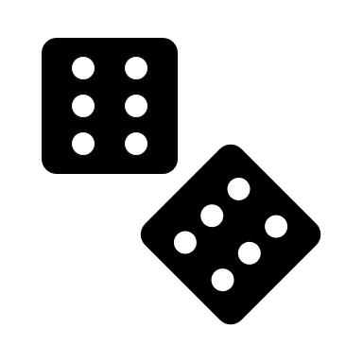

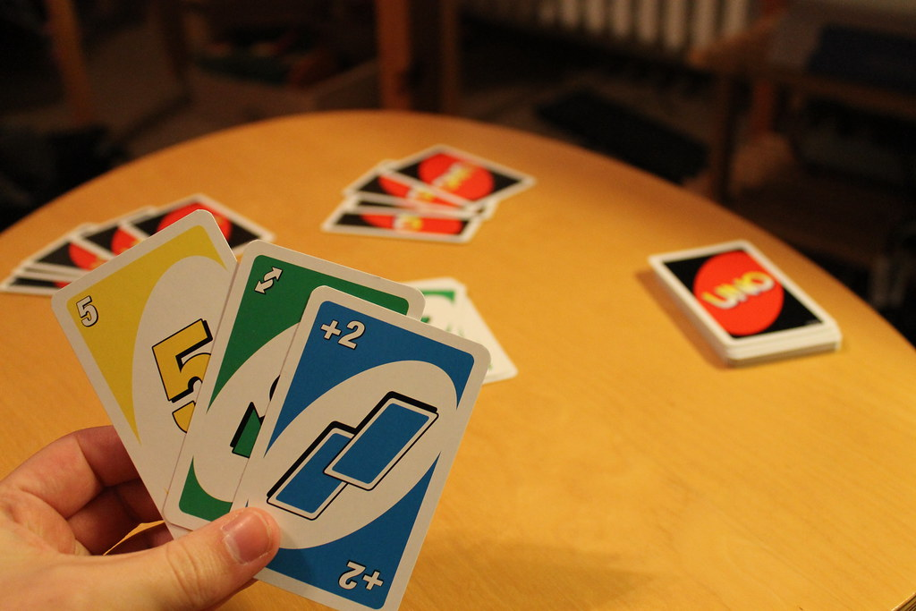
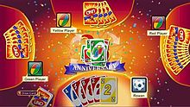
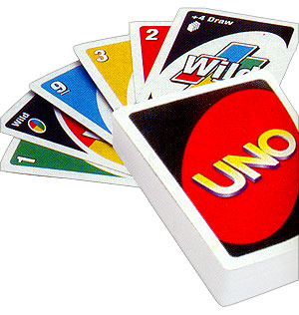

This Photo by Unknown Author is licensed under CC BY-ND
This Photo by Unknown Author is licensed under CC BY-SA
Computer Starts up the Automated Uno Game.
Adds the four computer players that will play the game.
The draw piles and discard piles are created. The first player then makes the first move of the game.
The first player either draws a card from the draw pile or they play an action card thus ending their turn.
This Photo by Unknown Author is licensed under CC BY-NC-ND
This Photo by Unknown Author is licensed under CC BY-NC-ND
This Photo by Unknown Author is licensed under CC BY-SA
The next player up goes ahead with their turn. As with the first player if they draw or play an action card their turn is ended
Each of the players go in turn refreshing the discard pile should the draw pile become low.
The game will go until one player has played all of their cards while saying or producing an UNO on screen for the computerized players.

